Slide 1


Miguel Angel Trejo
January 2024

Slide 2

Outline
Executive Summary
Introduction
Methodology
Results
Conclusion
Appendix

Slide 3
Executive Summary
Summary of methodologies.
Data collection.
Data wrangling.
Exploratory Data Analysis with Data Visualization.
Exploratory Data Analysis with SQL.
Building an interactive map with Folium.
Building a Dashboard with Plotly Dash.
Predictive analysis (Classification).
Summary of all results.
Exploratory Data Analysis results.
Interactive analytics demo in screenshots.
Predictive analysis results.

Slide 4
Introduction
Project background and context.
SpaceX is the most successful company of the commercial space age, making space travel affordable. The company advertises Falcon 9 rocket launches on its website, with a cost of 62 million dollars; other providers cost upward of 165 million dollars each, much of the savings is because SpaceX can reuse the first stage. Therefore, if we can determine if the first stage will land, we can determine the cost of a launch. Based on public information and machine learning models, we are going to predict if SpaceX will reuse the first stage.
Questions to be answered.
How do variables such as payload mass, launch site, number of flights, and orbits affect the success of the first stage landing?
Does the rate of successful landings increase over the years?
What is the best algorithm that can be used for binary classification in this case?

Slide 5

Section 1

Slide 6
Methodology
Executive Summary
Data collection methodology:
Using SpaceX REST API.
Using web scraping from Wikipedia
Perform data wrangling
Filtering the data.
Dealing with missing values.
Using One Hot Encoding to prepare the data to a binary classification
Perform exploratory data analysis (EDA) using visualization and SQL
Perform interactive visual analytics using Folium and Plotly Dash
Perform predictive analysis using classification models.
Building, tuning and evaluation of classification models to ensure the best results.

Slide 7
Data Collection
Data collection process involved a combination of API requests from SpaceX REST API and Web Scraping data from a table in SpaceX’s Wikipedia entry.
We had to use both of these data collection methods in order to get complete information about the launches for a more detailed analysis.
Data Columns are obtained by using SpaceX REST API:
FlightNumber, Date, BoosterVersion, PayloadMass, Orbit, LaunchSite, Outcome, Flights, GridFins, Reused, Legs, LandingPad, Block, ReusedCount, Serial, Longitude, Latitude.
Data Columns are obtained by using Wikipedia Web Scraping:
Flight No., Launch site, Payload, PayloadMass, Orbit, Customer, Launch outcome, Version Booster, Booster landing, Date, Time.

Slide 8
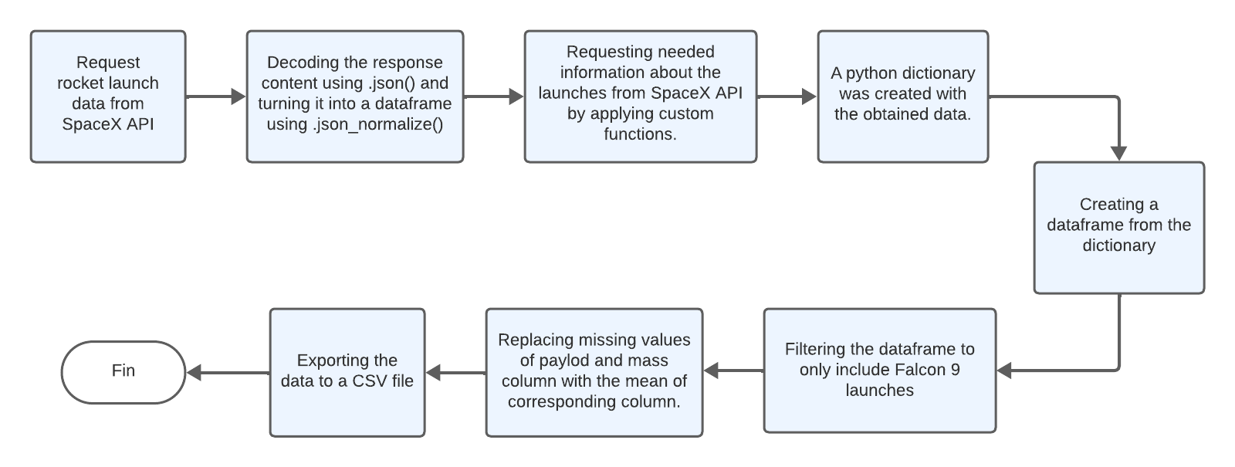
Data Collection – SpaceX API
GitHub Link

Slide 9
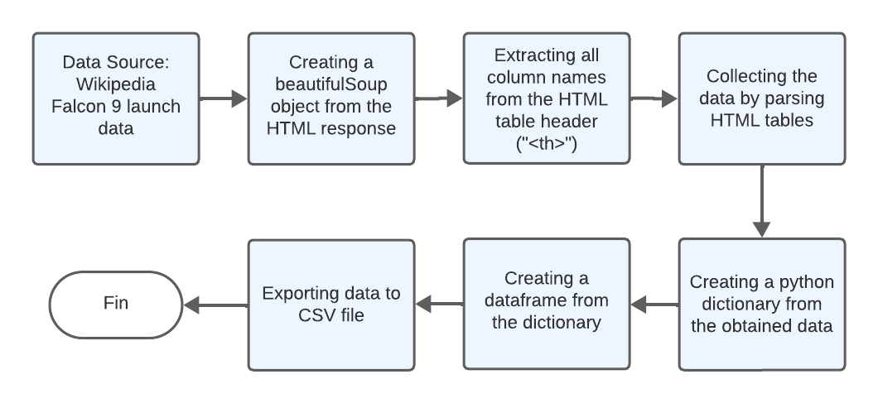
Data Collection - Scraping
GitHub link

Slide 10
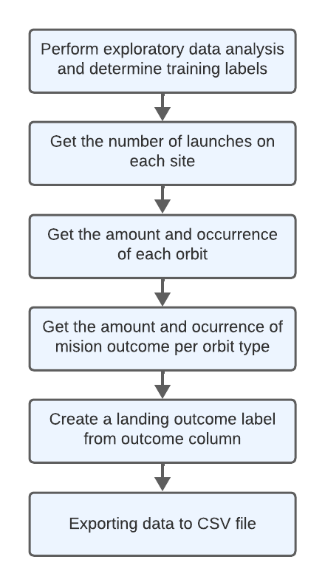
Data Wrangling
In the data set, there are several different cases where the booster did not land successfully. Sometimes a landing was attempted but failed due to an accident; for example, True Ocean means the mission outcome was successfully landed to a specific region of the ocean while False Ocean means the mission outcome was unsuccessfully landed to a specific region of the ocean. True RTLS means the mission outcome was successfully landed to a ground pad False RTLS means the mission outcome was unsuccessfully landed to a ground pad. True ASDS means the mission outcome was successfully landed on a drone ship False ASDS means the mission outcome was unsuccessfully landed on a drone ship.
GitHub link

Slide 11
EDA with Data Visualization
Flight number vs Payload Mass.
Flight number vs Launch Site.
Payload Mass vs Launch Site.
Orbit Type vs Success rate.
Flight number vs Orbit Type.
Payload Mass vs Orbit Type and Success Rate Yearly Trend.
Scatter plots show the relationship between variables. If a relationship exists, they could be used in machine learning model. Bar charts show comparisons among discrete categories. The goal is to show the relationship between the specific categories being compared and a measured value. Line charts show trends in data over time (time series).
GitHub link.

Slide 12
EDA with SQL
SQL queries performed.
Display the names of the unique launch sites in the space mission.
Display 5 records where launch sites begin with the string 'CCA’.
Display the total payload mass carried by boosters launched by NASA (CRS).
Display average payload mass carried by booster version F9 v1.1.
List the date when the first successful landing outcome in ground pad was achieved.
List the names of the boosters which have success in drone ship and have payload mass greater than 4000 but less than 6000.
List the total number of successful and failure mission outcomes.
List the names of the booster versions which have carried the maximum payload mass. Use a subquery.
List the records which will display the month names, failure landing outcomes in drone ship ,booster versions, launch site for the months in year 2015.
Rank the count of landing outcomes (such as Failure (drone ship) or Success (ground pad)) between the date 2010-06-04 and 2017-03-20, in descending order.
GitHub link

Slide 13
Build an Interactive Map with Folium
Marker with circle, pop up label and text label of NASA Johnson Space Center using its latitude and longitude coordinates as a start location.
Marker with circle, pop up label and text label of all launch sites using their latitude and longitude coordinates to show their geographical location and proximity to Equator and coasts.
Colored Markers of the launch outcomes for each Launch Site:
Added colored Markers of success (Green) and failed (Red) launches using Marker Cluster to identify which launch sites have relatively high success rates.
Added colored Markers of success (Green) and failed (Red) launches using Marker Cluster to
Identify which launch sites have relatively high success rates.
Added colored Lines to show distances between the Launch Site KSC LC-39A (as an example) and its proximities like Railway, Highway, Coastline and Closest City.
GitHub Link.

Slide 14
Build a Dashboard with Plotly Dash
Launch Sites Dropdown List:
Added a dropdown list to enable Launch Site selection using dcc.Dropdown from plotly library.
Pie Chart showing Success Launches (All Sites/Certain Site):
Added a pie chart to show the total successful launches count for all sites and the Success vs. Failed counts for the site, if a specific Launch Site was selected.
Slider of Payload Mass Range:
Added a slider to select Payload range using dcc.Slider from plotly library.
Scatter Chart of Payload Mass vs. Success Rate for the different Booster Versions:
Added a scatter chart to show the correlation between Payload and Launch Success.
Graphs was created using plotly.express library.
GitHub Link.

Slide 15
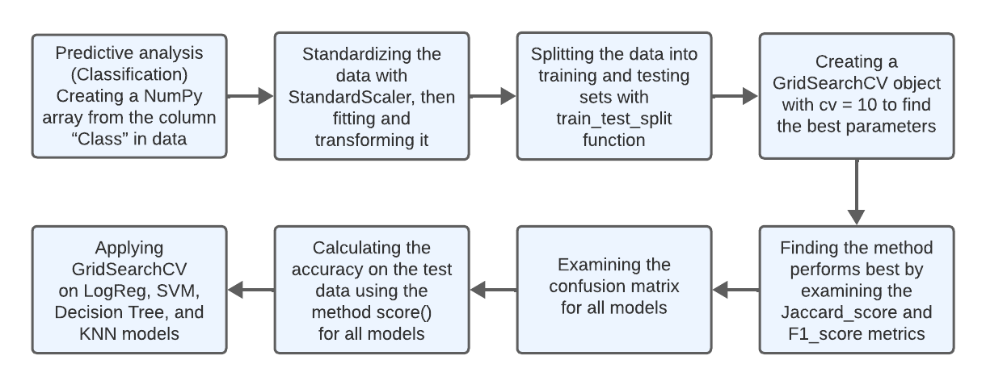
Predictive Analysis (Classification)

Slide 16
Results
Exploratory data analysis results
Interactive analytics demo in screenshots
Predictive analysis results

Slide 17

Section 2

Slide 18
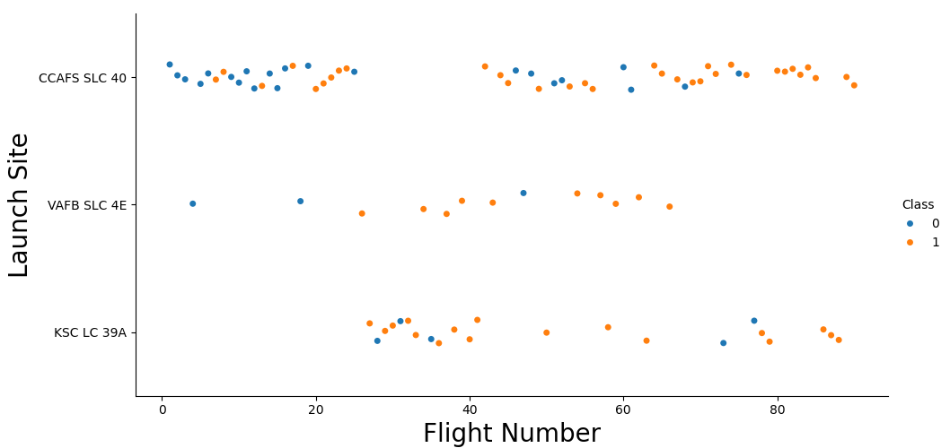
Flight Number vs. Launch Site
The earliest flights all failed while the latest flights all succeeded.
The CCAFS SLC 40 launch site has about a half of all launches.
VAFB SLC 4E and KSC LC 39A have higher success rates.
It can be assumed that each new launch has a higher rate of success.

Slide 19
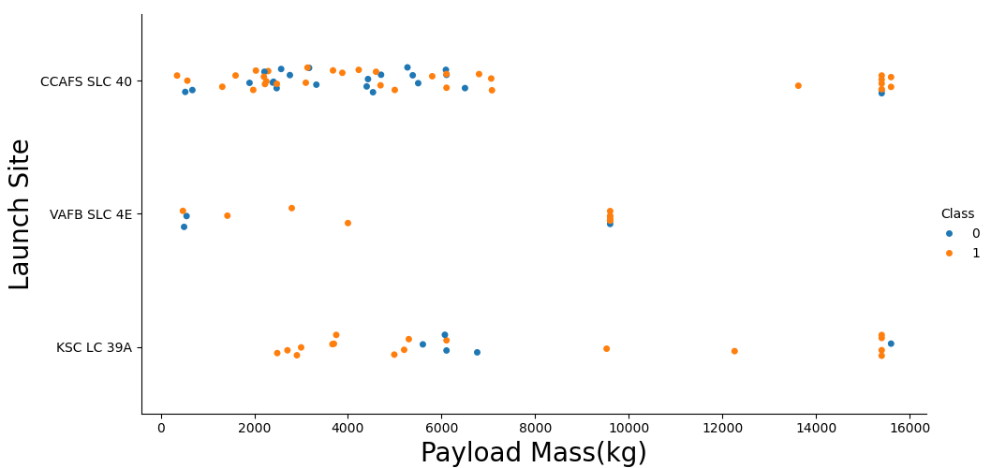
Payload vs. Launch Site
For every launch site the higher the payload mass, the higher the success rate.
Most of the launches with payload mass over 7000 kg were successful.
KSC LC 39A has a 100% success rate for payload mass under 5500 kg too.

Slide 20
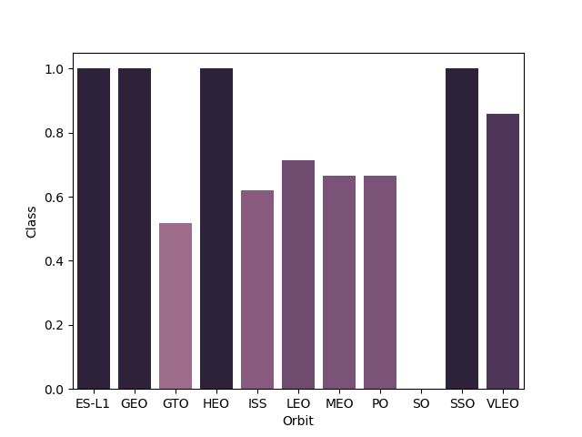
Success Rate vs. Orbit Type
Orbits with 100% success rate:
ES-L1, GEO, HEO, SSO
Orbits with 0% success rate:
SO
Orbits with success rate: between 50% and 85%:
GTO, ISS, LEO, MEO, PO

Slide 21
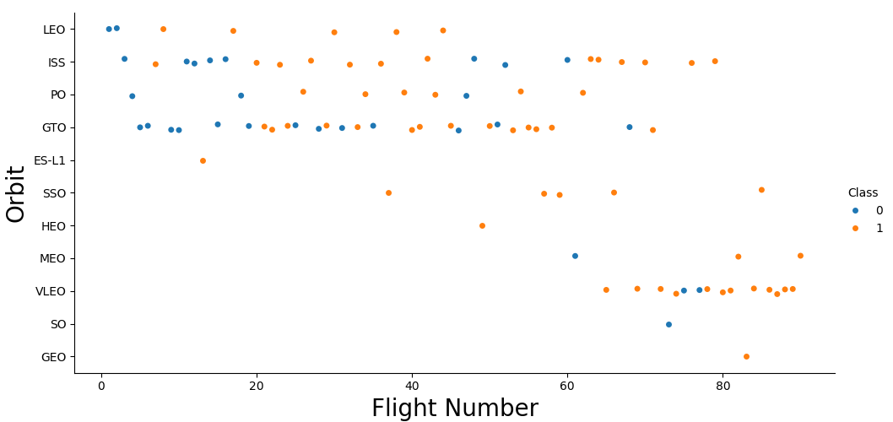
Flight Number vs. Orbit Type
In the LEO orbit the Success appears related to the number of flights; on the other hand, there seems to be no relationship between flight number when in GTO orbit.

Slide 22
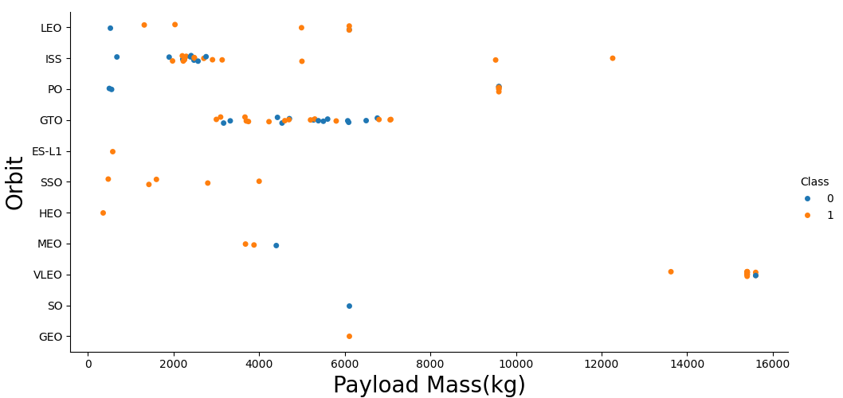
Payload vs. Orbit Type
Heavy payloads have a negative influence on GTO orbits and positive on GTO and Polar LEO (ISS) orbits.

Slide 23
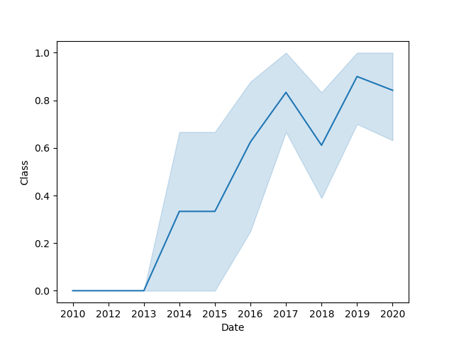
Launch Success Yearly Trend
The success rate since 2013 kept increasing till 2020.

Slide 24
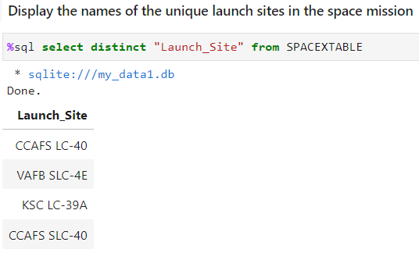
All Launch Site Names
To obtain the launch sites names we use SELECT DISTINCT statement

Slide 25
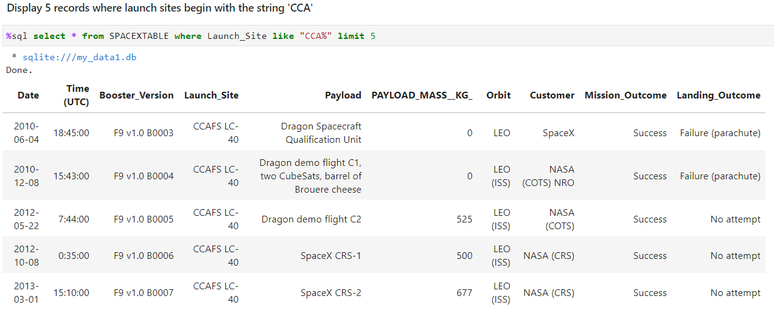
Launch Site Names Begin with 'CCA'
The like operator was used to find the sites names begin with ‘CCA’ pattern.

Slide 26
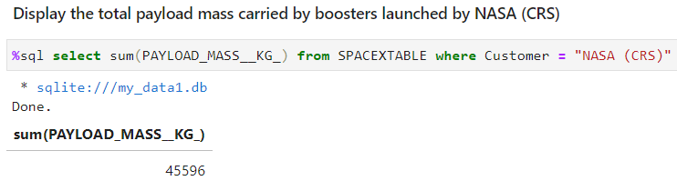
Total Payload Mass
SUM function was used to obtain the total payload mass for specified customer.

Slide 27
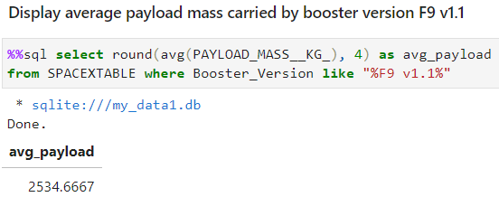
Average Payload Mass by F9 v1.1
We filter the results using the like operator and the average function.

Slide 28
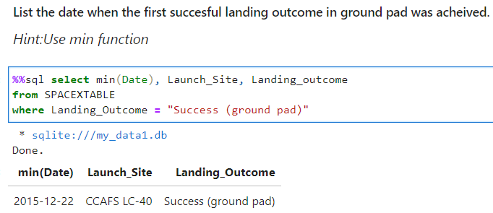
First Successful Ground Landing Date
Function min was used in the select statement to obtain the first successful landing outcome in ground pad

Slide 29
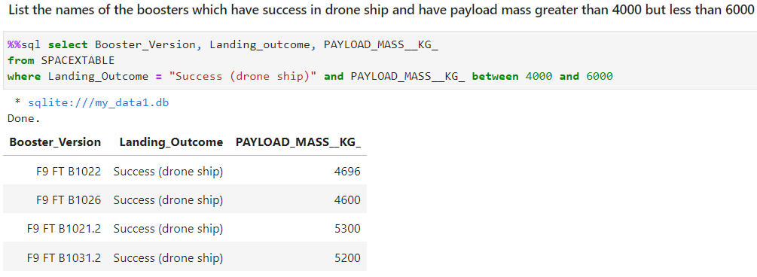
Successful Drone Ship Landing with Payload between 4000 and 6000
Between operator was used in the select statement to obtain the results

Slide 30
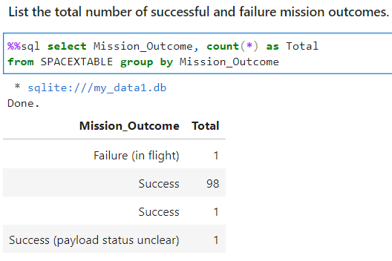
Total Number of Successful and Failure Mission Outcomes
Group by clause and count function was used to obtain the results to the select statement.

Slide 31
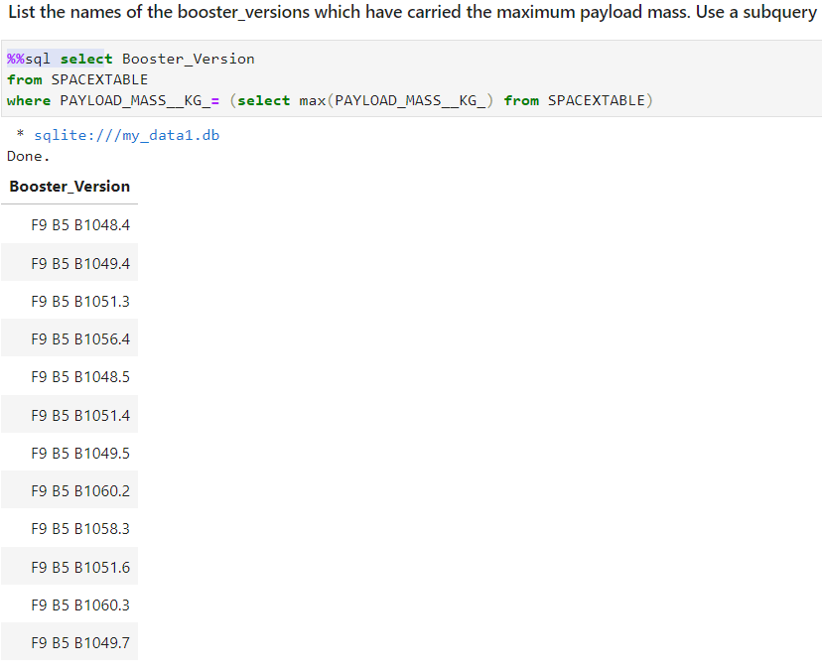
Boosters Carried Maximum Payload
To obtain the results was necessary to execute a subquery where the max function was used.

Slide 32
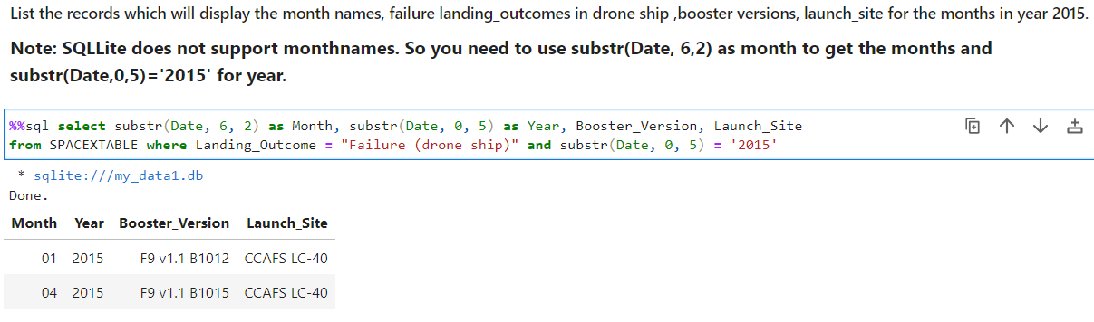
2015 Launch Records

Slide 33
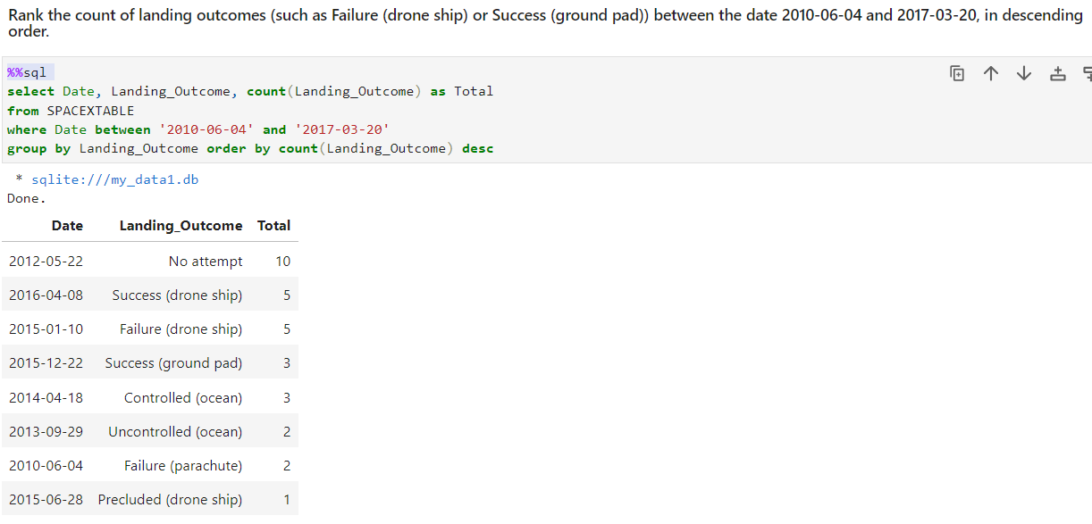
Rank Landing Outcomes Between 2010-06-04 and 2017-03-20

Slide 34

Section 3

Slide 35
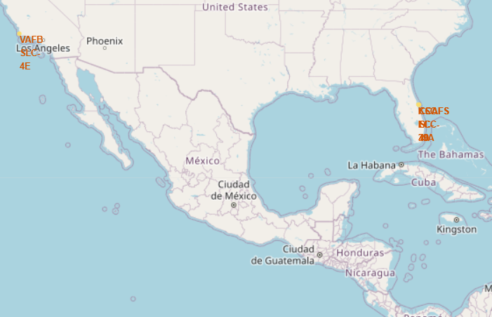
Markers of launch sites
Most of Launch sites are in proximity to the Equator line. If a spacecraft is launched from a site near Earth's equator, it can take optimum advantage of the Earth's substantial rotational speed. Sitting on the launch pad near the equator, it is already moving at a speed of over 1650 km per hour relative to Earth's center. This can be applied to the speed required to orbit the Earth (approximately 28,000 km per hour).
All launch sites are in very close proximity to the coast, while launching rockets towards the ocean it minimizes the risk of having any debris dropping or exploding near people.

Slide 36
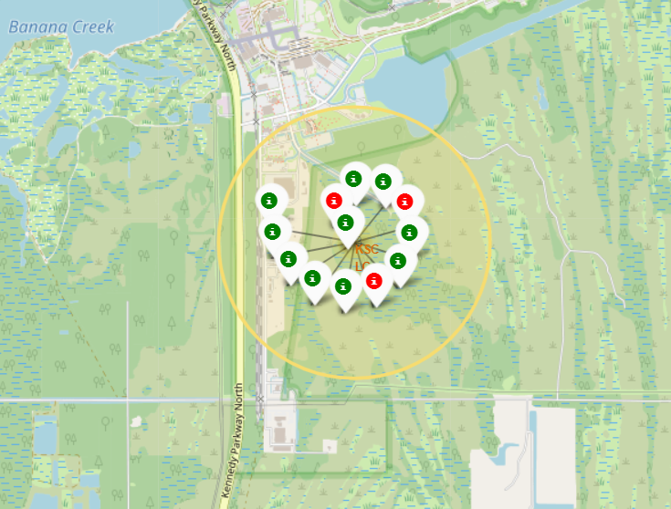
Color-labeled launch records on the map
From the color-labeled markers we should be able to easily. identify which launch sites have relatively high success rates.
Green Marker = Successful Launch
Red Marker = Failed Launch
Launch Site KSC LC-39A has a very high Success Rate.

Slide 37
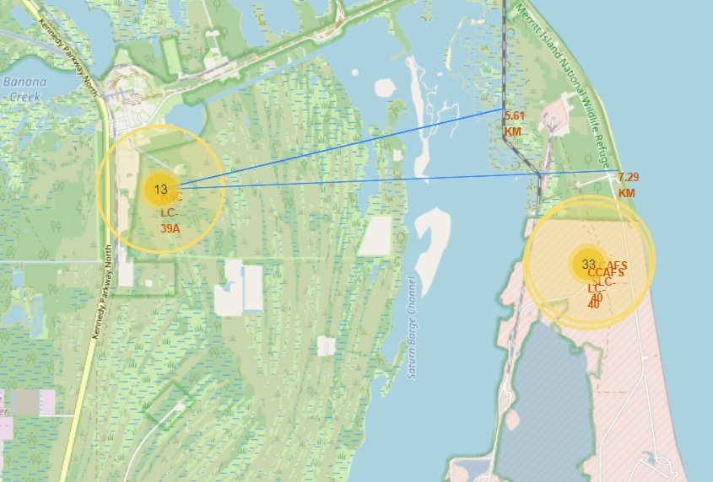
Distance from the launch site KSC LC-39A to its proximities
Launch sites are in close proximity to railways, highways and coast line.
Launch site KSC LC-39A is relative close to its closest city Titusville (16.32 km).

Slide 38

Section 4

Slide 39
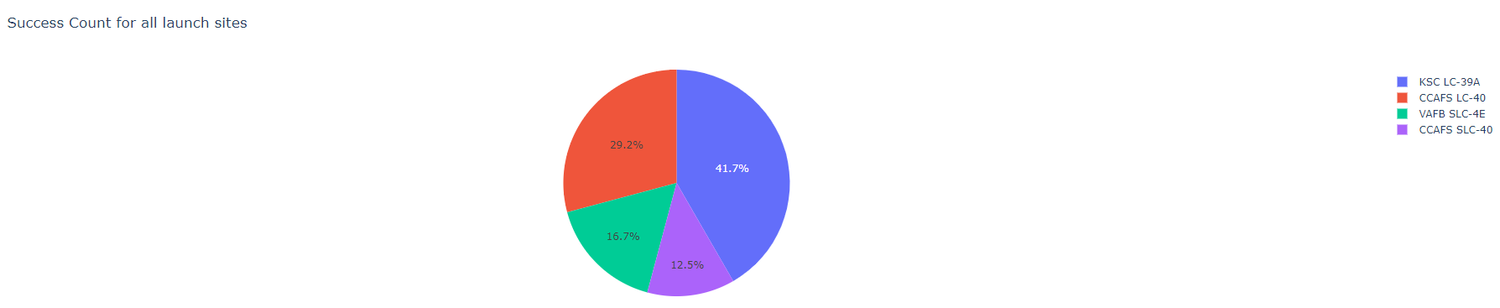
Launch success count for all sites
The chart shows that KSC LC-39A has the most successful launches.

Slide 40
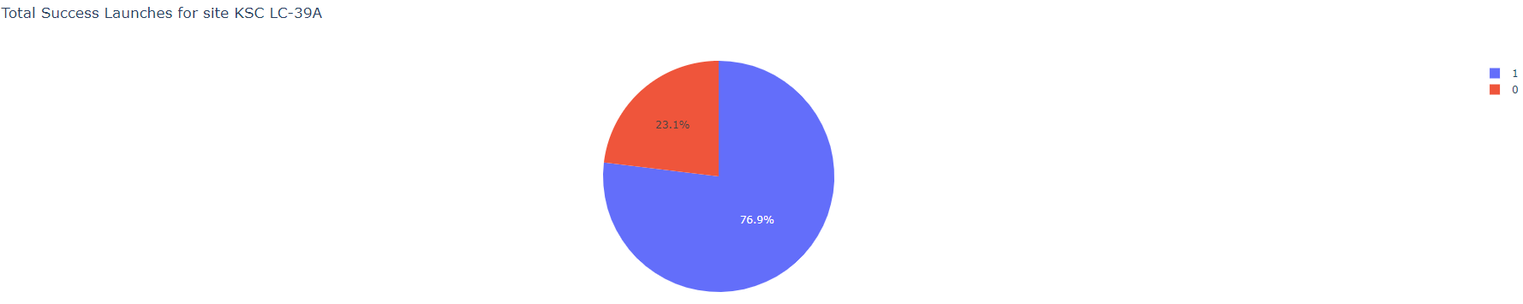
Launch site with highest launch success ratio.
For KSC LC-39A there are success rate of 76.9% with 10 successful and only 3 failed landings.

Slide 41
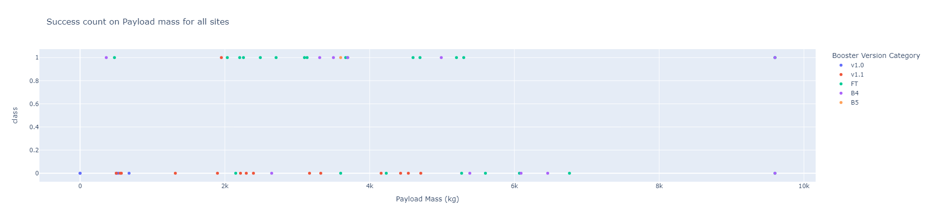
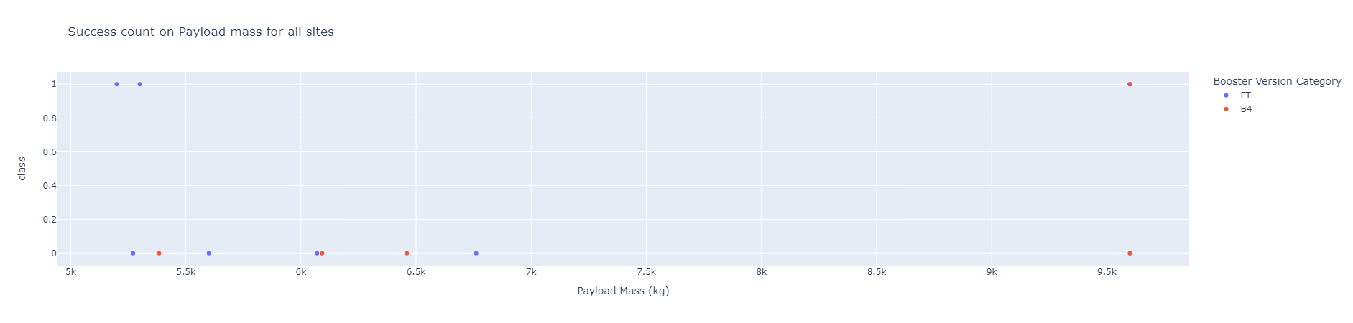
Payload Mass vs. Launch Outcome for all sites
Payloads between 2000 and 5500 kg have the highest success rate.

Slide 42

Section 5

Slide 43
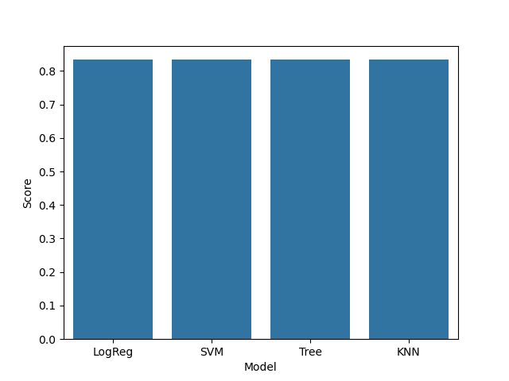
Classification Accuracy
Practically all algorithms give the same result.
Accuracy for Logistics Regression method: 0.8333333333333334
Accuracy for Support Vector Machine method: 0.8333333333333334
Accuracy for Decision tree method: 0.8333333333333334
Accuracy for K nearest neighbors method: 0.8333333333333334

Slide 44
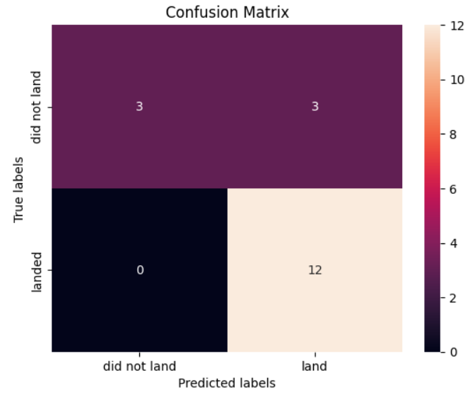
Confusion Matrix
All models can distinguish between different classes.
The major problem is false positives.

Slide 45
Conclusions
With the obtained results we can select any model to predict landing.
Launches with a low payload mass show better results than launches with a larger payload mass.
Most of launch sites are in proximity to the Equator line and all the sites are in very close proximity to the coast.
The success rate of launches increases over the years.
KSC LC-39A has the highest success rate of the launches from all the sites.
Orbits ES-L1, GEO, HEO and SSO have 100% success rate.

Slide 46
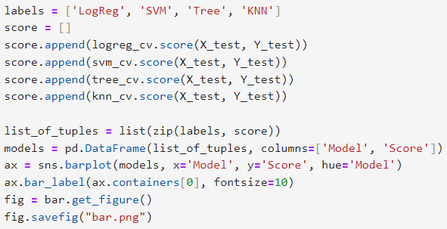
Appendix
Code to create bar chart for the different classifiers.

Slide 47


